Slide 1
ATTENDENCE SYSTEM ANDROID PROJECT
GOURI SANKAR RATH 200301120121
ASHUTOSH BISWAL 20301120169
PRANAB PRABHANJAN SAHOO 200301120151
SANGRAM BHUYAN
200301120065

Slide 2
ABSTRACT:-
Now a days, it is highly possible to adapt mobile computing in various applications. The portability, open source
Nature of smart phones and android development platform has made the development of application software for various
Wireless communication technology of smart phone enables the information transfer from the current client to remote
Database server, where ever the network range is available. The Attendance System is a mobile computing software
Application, which focuses on an activity or function, which is based on management information system of academic

Slide 3
INTRODUCTION:-
Android Attendance System is a software developed for daily student attendance in schools, colleges and institutes. If
Facilitates to access the attendance information of a particular student in a particular class. The information is sorted by the
Operators, which will be provided by the teacher for a particular class. This system will also help in evaluating attendance
Eligibility criteria of a student.

Slide 4
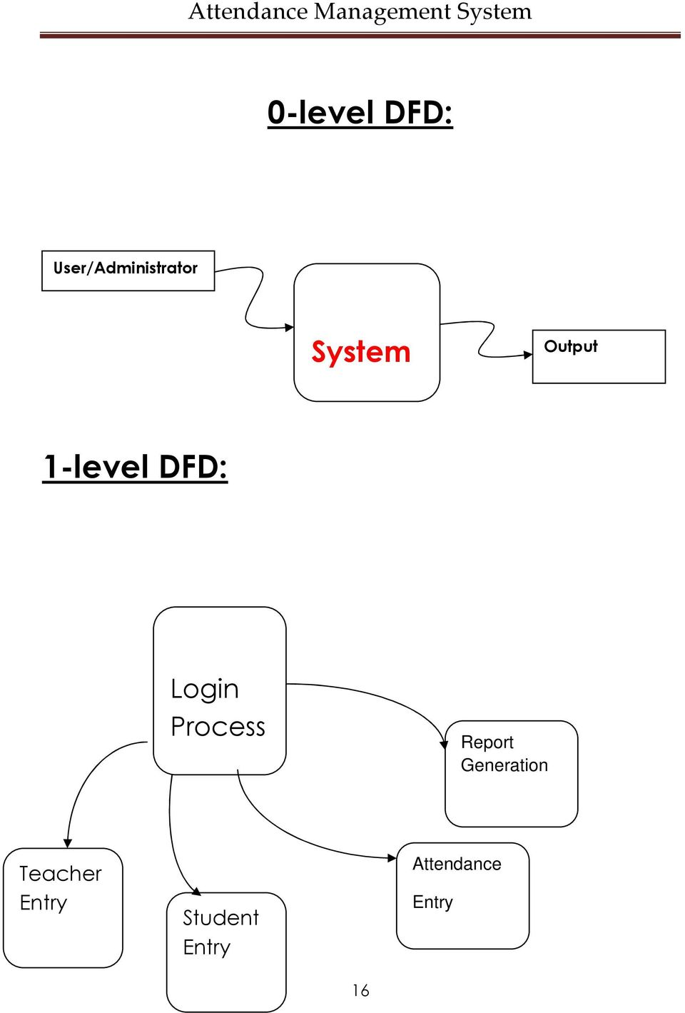
DATA FLOW DIAGRAM

Slide 5
ADVANTAGE AND DISADVANTAGE
ADVANTAGE
DISADVANTAGE
There is no need for laptop or computer in every class to run the system as the system is run on mobile so no need of
extra efforts and resources.
The app is easy to install and use.
Absentees are easily identified and information's are passed to the respective student parents in faster way.
Parents can easily understand attendance performance of their children.
This application is so simple and easily understandable to every person.
Reduce communication gap between teacher and parent.
The system can be run on android platform only. Though most of the mobiles now are android version and available in reasonable rate so it won’t be a big issue.

Slide 6
SOFTWARE/HARDWARE REQUIREMENTS
Software Requirements
Operating System: Windows 7
Language: Android SDK, Java
Database: MySQL
Tools: Eclipse IDE, Android Plug-in for Eclipse
Technologies used: Java, PHP, XML.
Debugger: Android Dalvik Debug Monitor service
Server: XAMPP Server
Operating System: Android 4.2 or higher versions
Hardware Requirements
RAM: 2 GB
Storage: 1GB or less
Devices: Android or Ios
Version of device: 4.2 or higher

Slide 7
FUTURE SCOPE
The scope of the project is the system on which the software is installed, i.e. the project is developed as a desktop application,and it will work for a particular institute. But later on the project can be modified to operate it online .

Slide 8
CONCLUSION:-
This application holds a huge scope off uterine hatchments and improvements. Some significant points are listed below:
We can make the attendance module more dynamic where in feature of skipping the day could be made avail belt the user. Skipping of an attendance day shall be relevant circumstances where there is a holiday in the college; the teacher is on unplanned leave, etc. The feature of customizing student detail within a batch, addition, deletion, deletion and modification of a batch, customization of subjects are big future enhancement possibility in our application. This shall make our application more dynamic, giving it are a lactic look and feel.

Slide 9
REFERENCES:-
1. http://www.android-x86.org/releases/releasenote-4-4-r1
2. http://developer.android.com/develop/index.html
3. http://www.fao.org/docrep/w7506e/w7506e03.htm

Slide 10


